Slide 1
Capstone Project
Bike Sharing Demand Prediction
By-
Navneet Singh

Slide 2
Problem statement
The contents of the data came from a city called Seoul. A bike-sharing system is a service in which bikes are made available for shared use to individuals on a short term basis for a price or free.The data had variables such as date, hour, temperature, humidity, wind-speed, visibility, dew point temperature, solar radiation, rainfall, snowfall, seasons, holiday, functioning day and rented bike count.The problem statement was to build a machine learning model that could predict the rented bikes count required for an hour, given other variables

Slide 3
Points to discuss
Data description and summary
Analysis of categorical variable
Analysis of numerical variable
Handling outliers
Regression plot
Machine learning algorithms
conclusion

Slide 4
Data description
The dataset contains weather information (Temperature, Humidity, Windspeed, Visibility, Dewpoint, Solar radiation, Snowfall, Rainfall), the number of bikes rented per hour and date information.
Date : year-month-day
Rented Bike count - Count of bikes rented at each hour
Hour - Hour of the day
Temperature - Temperature in Celsius
Humidity - %
Windspeed - m/s
Visibility - 10m
Dew point temperature - Celsius
Solar radiation - MJ/m2
Rainfall - mm

Slide 5
Data description(cont,.)
Snowfall - cm
Seasons - Winter, Spring, Summer, Autumn
Holiday - Holiday/No holiday
Functional Day - NoFunc(Non Functional Hours), Fun(Functional hours)
This dataset contains 8760 lines and 14 columns
Numerical variables - temperature, humidity,wind,visibility,dew point temp, solar radiation,rainfall,snowfall
Categorical variables - seasons,holiday and functioning day
Rented bike column - which we need to predict for new observations

Slide 6
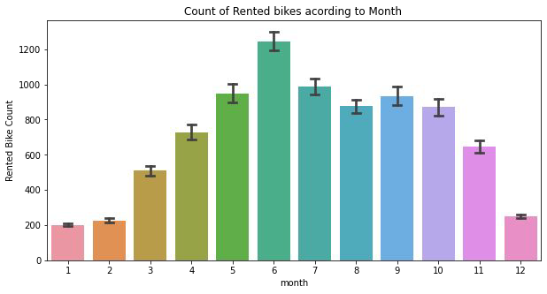
Month
The demand of the rented bike is high from the month 5 to 10

Slide 7
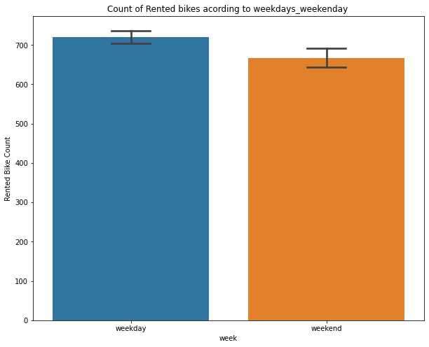
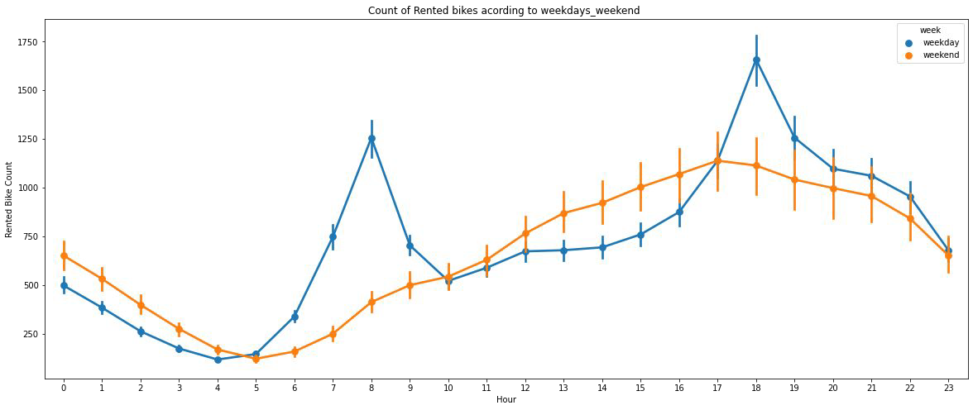
week
From the above point plot and bar plot we can say that in the week days which represent in blue colur show that the demand of the bike higher because of the oﬃce. Peak Time are 7 am to 9 am and 5 pm to 7 pm The orange colour represent the weekend days, and it show that the demand of rented bikes are very low specially in the morning hour but when the evening start from 4 pm to 8 pm the demand slightly increases

Slide 8
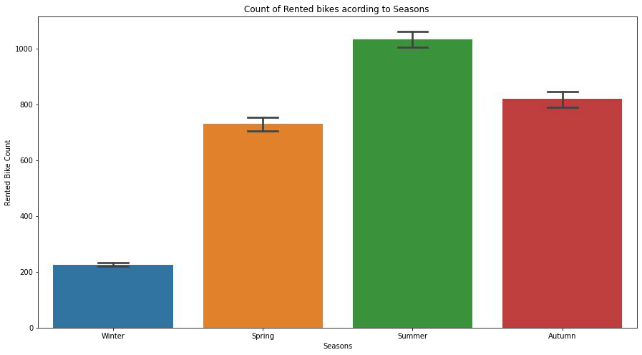
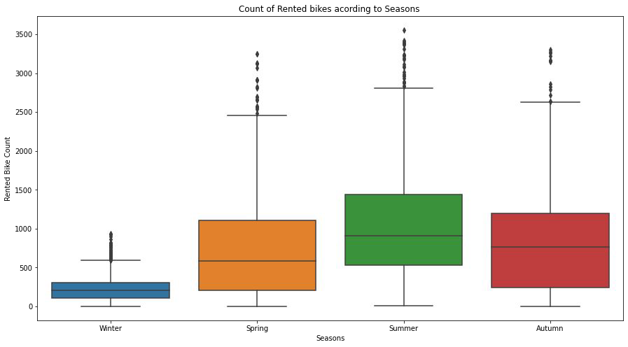
seasons
In the above box plot and bar plot which shows the use of rented bike in in four different seasons, and it clearly shows that, In summer season the use of rented bike is high In winter season the use of rented bike is very low because of snowfall.

Slide 9
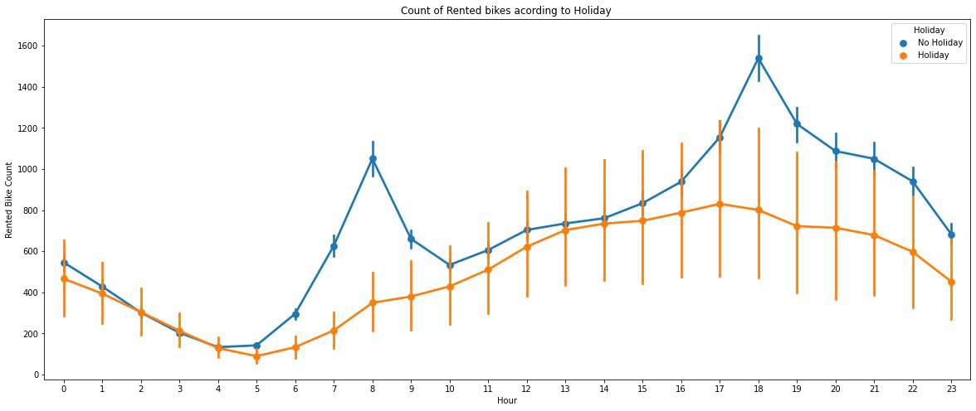
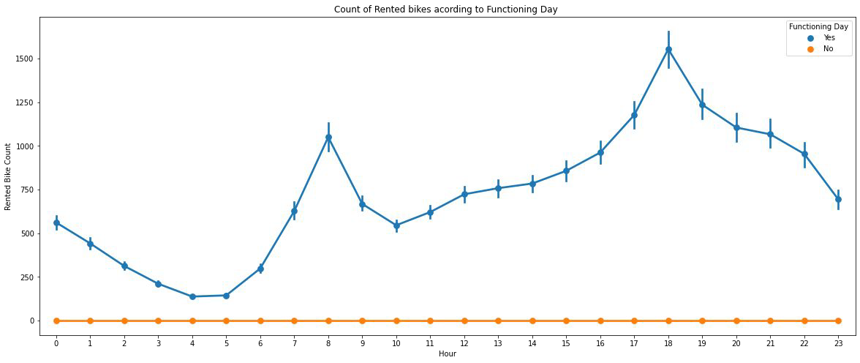
Holiday
Functioning day
In the above point plot which shows
In the above point plot which shows the use of rented bike in functioning day or not, and it clearly shows that, Peoples dont use reneted bikes in no functioning day
the use of rented bike in a holiday, and
it clearly shows that, plot shows that in holiday people uses the rented bike from 2pm-8pm

Slide 10
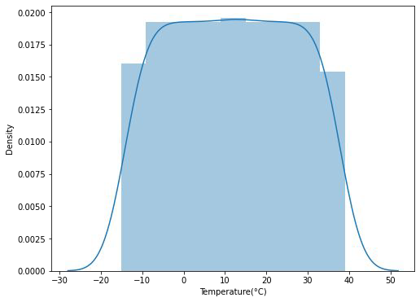
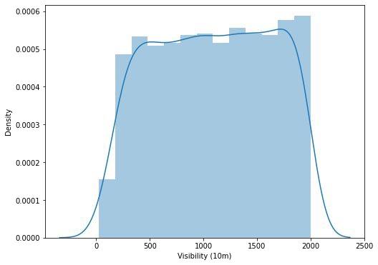
Numerical variables
Temperature
visibility
Above plot shows that people
Above plot shows that people tend to rent bikes when the visibility is bet- ween 300 to 1700
tend to rent bikes when the
temperature is between -5 to 25 degrees.

Slide 11
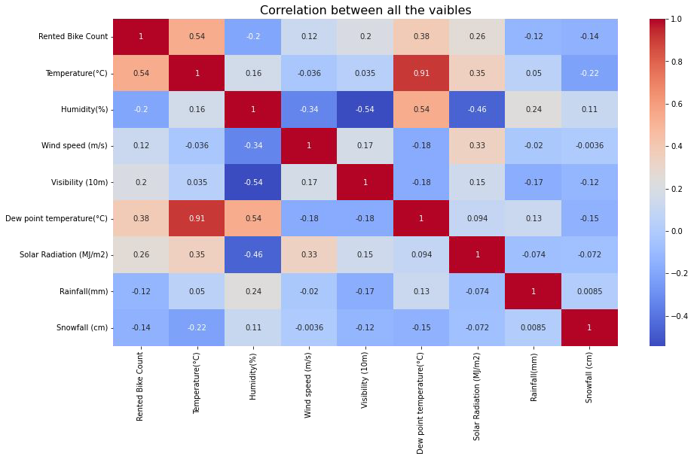
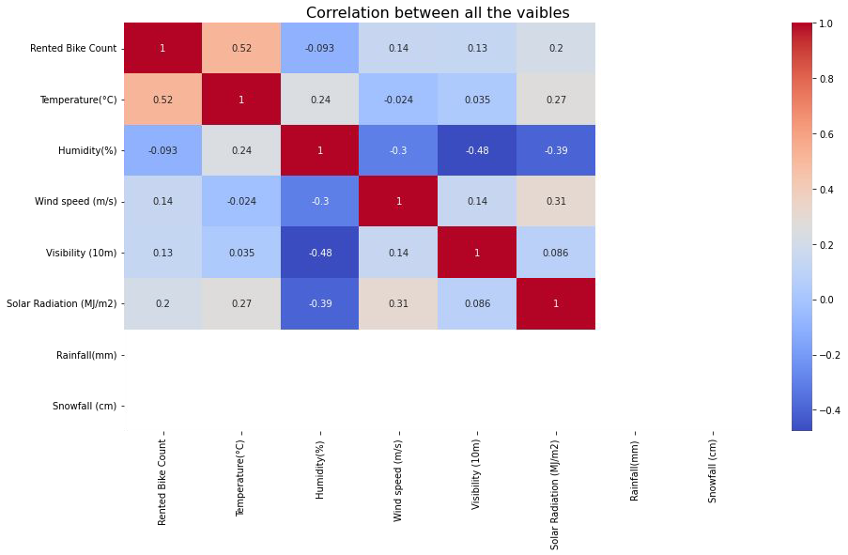
Heat map
From the above heat map i can conclude that Temperature and Dew point temperature(°C) has the high correlation . we drop this column then it dont affects the outcome of our analysis
After removing the Dew point temperature

Slide 12
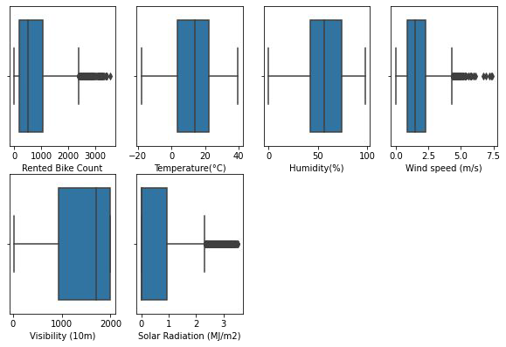
Handling outliers
An Outlier is a data-item/object that deviates signiﬁcantly from the rest of the (so-called normal)objects,The interquartile range (IQR) is the difference between the 75th and 25th percentile of the data. It is a measure of the dispersion similar to standard deviation or variance, but is much more robust against outlier

Slide 13
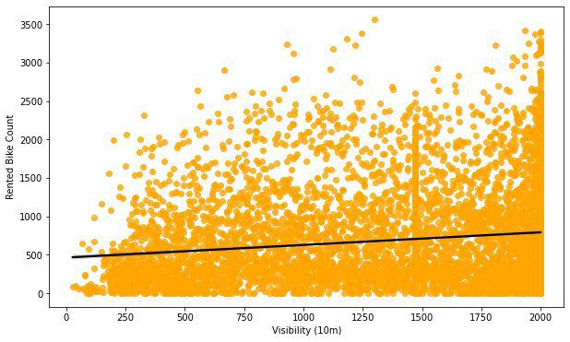
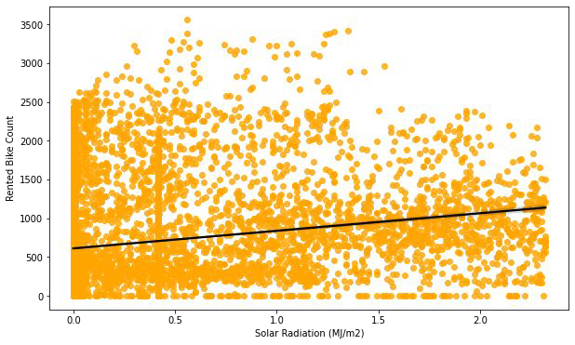
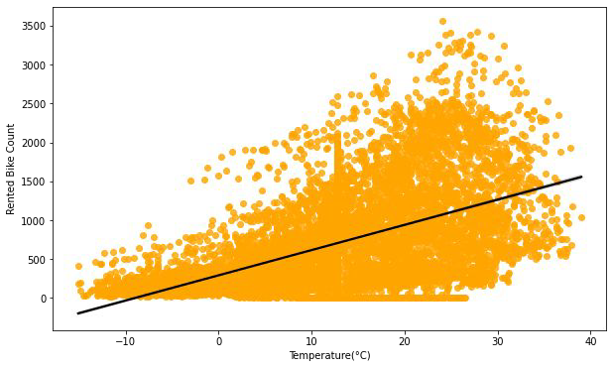
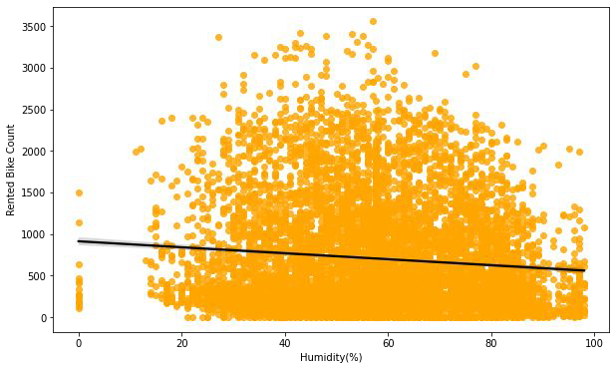
Regression plot

Slide 14
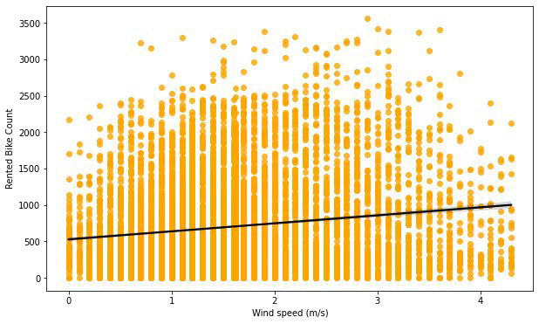
Temperature,solar radiation,wind speed,visibility are positively related to target variable ,the rented bike count increases with increase of these features

Slide 15
ML algorithms
Linear regression
Ridge regression
Elastic net
Decision tree
Random Forest regressor
SVR
Gradient boosting

Slide 16
Linear regression
MSE : 61.15584375724336
RMSE : 7.820220185982192
MAE : 5.923260387972038
R2 : 0.6028600936479797
Adjusted R2 : 0.5979004370931673
Ridge regularization
MSE : 60.83384712272495
RMSE : 7.799605574817546
R2 : 0.6148937632652991
Adjusted R2 : 0.6100843884309619
linear regression with elastic net
MSE : 61.36957118125049
RMSE : 7.833873319198523
MAE : 5.93382066577593
R2 : 0.6014721692250582
Adjusted R2 : 0.5964951796640391

Slide 17
Random Forest Regressor with GridSearchCV
Decision tree
The r2 score of decision tree is 0.7619882672759375
the r2 score of decision tree with hyper perameteres tunning is 0.8013257980814106
MSE= 7.548469131956553
RMSE= 2.747447748721812
R2_Score_train= 0.9509809996888273
MSE= 19.900384576287564
RMSE= 4.460984709264039
R2_Score_test= 0.8740214111679199

Slide 18
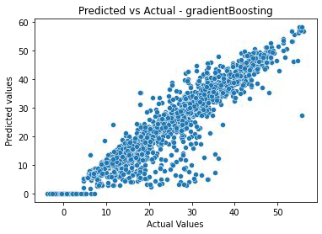
SVR using grid search cv
The MAE of training set = 4.312974309168605 The MSE of training set = 44.525880818380806
The R2_score of training set = 0.7108534025195494 The MAE of test set = 4.674553587050071
The MSE of test set = 46.854036819585005 The R2_score of test set = 0.703392393398722
Gradient Boosting Regressor with GridSearchCV
R2 score of training data: 0.91% R2 score of test data: 0.869495

Slide 19
conclusion
Hour of the day holds most importance among all the features for prediction of dataset
It is observed that highest number bike rentals counts in Autumn/fall Summer Seasons and the lowest in Spring season.
We observed that the highest number of bike rentals on a clear day and the lowest on a snowy or rainy day
the top 5 important features of our dataset are: Season_winter, Temperature, Hour, Season_autumn, Humidity
Peoples dont use rented bikes in no functioning day
people tend to rent bikes when the temperature is between -5 to 25 degrees
people tend to rent bikes when the visibility is between 300 to 1700
for all the above experiments we can conclude that gradient boosting and random forest regressor with using hyperparameters we got the best results

